Slide 1

CHAPTER 11
ANALYSIS OF
ALGORITHM
EFFICIENCY
Copyright © Cengage Learning. All rights reserved.

Slide 2
SECTION 11.1
Real-Valued Functions of a Real Variable
and Their Graphs
Copyright © Cengage Learning. All rights reserved.

Slide 3
Real-Valued Functions of a Real Variable and Their Graphs
A Cartesian plane or two-dimensional Cartesian coordinate system is a pictorial representation of R × R obtained by setting up a one-to-one correspondence between ordered pairs of real numbers and points in a Euclidean plane.
To obtain it, two perpendicular lines, called the horizontal and vertical axes, are drawn in the plane. Their point of intersection is called the origin, and a unit of distance is chosen for each axis.

Slide 4
Real-Valued Functions of a Real Variable and Their Graphs
An ordered pair (x, y) of real numbers corresponds to the point P that lies | x | units to the right or left of the vertical axis and | y | units above or below the horizontal axis.
On each axis the positive direction is marked with an arrow.
A real-valued function of a real variable is a function from one set of real numbers to another.
If f is such a function, then for each real number x in the domain of f, there is a unique corresponding real number
f (x).

Slide 5
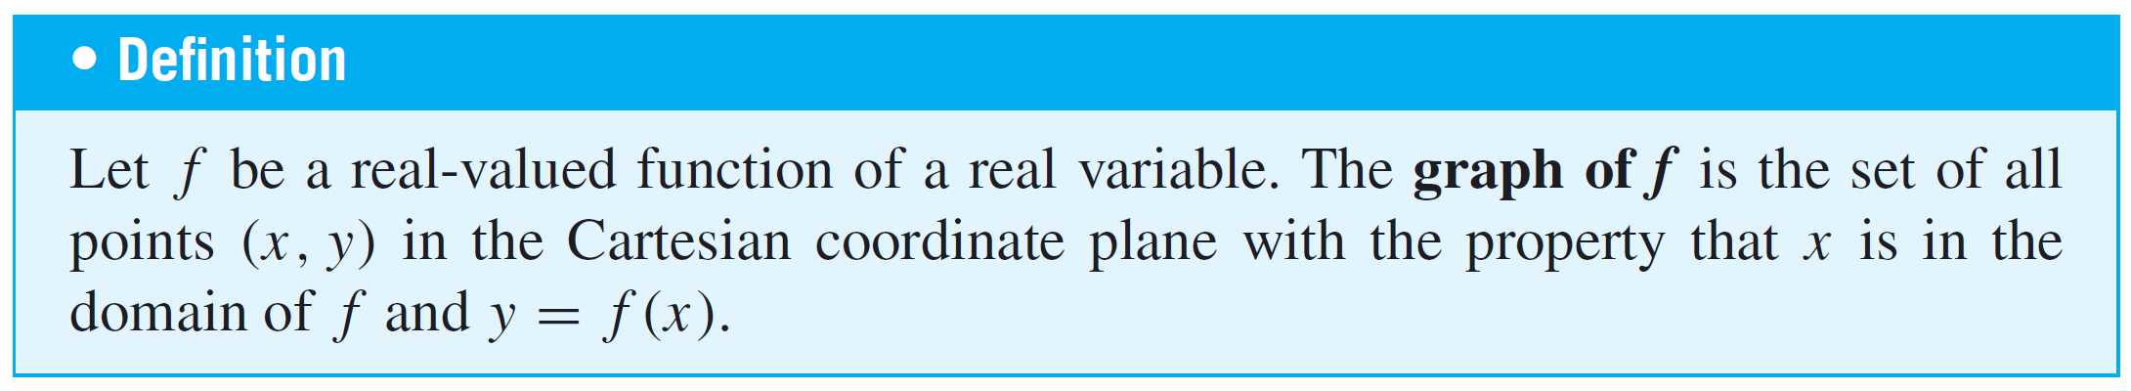
Real-Valued Functions of a Real Variable and Their Graphs
Thus it is possible to define the graph of f as follows:

Slide 6
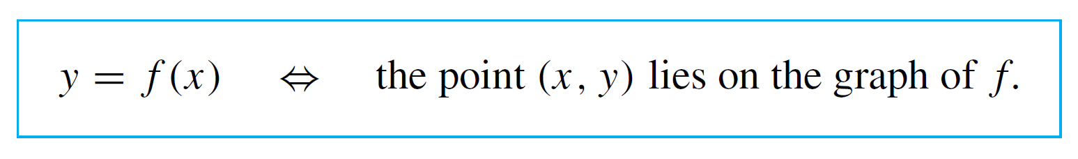
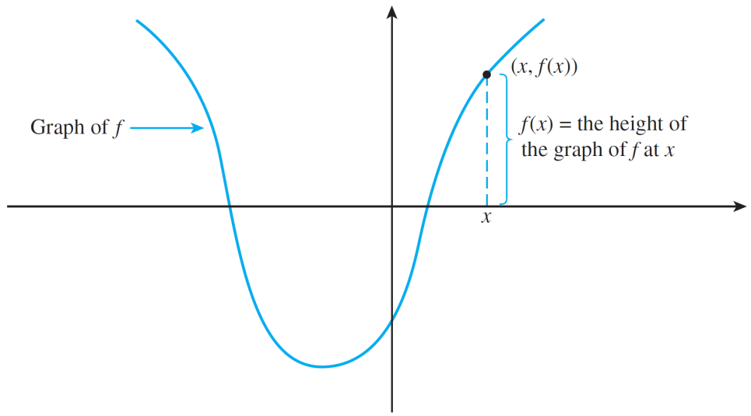
Real-Valued Functions of a Real Variable and Their Graphs
The definition of graph (see Figure 11.1.1) means that for all x in the domain of f :
Graph of a Function f
Figure 11.1.1

Slide 7
Real-Valued Functions of a Real Variable and Their Graphs
Note that if f (x) can be written as an algebraic expression in x, the graph of the function f is the same as the graph of the equation y = f (x) where x is restricted to lie in the domain of f.

Slide 8
Power Functions

Slide 9
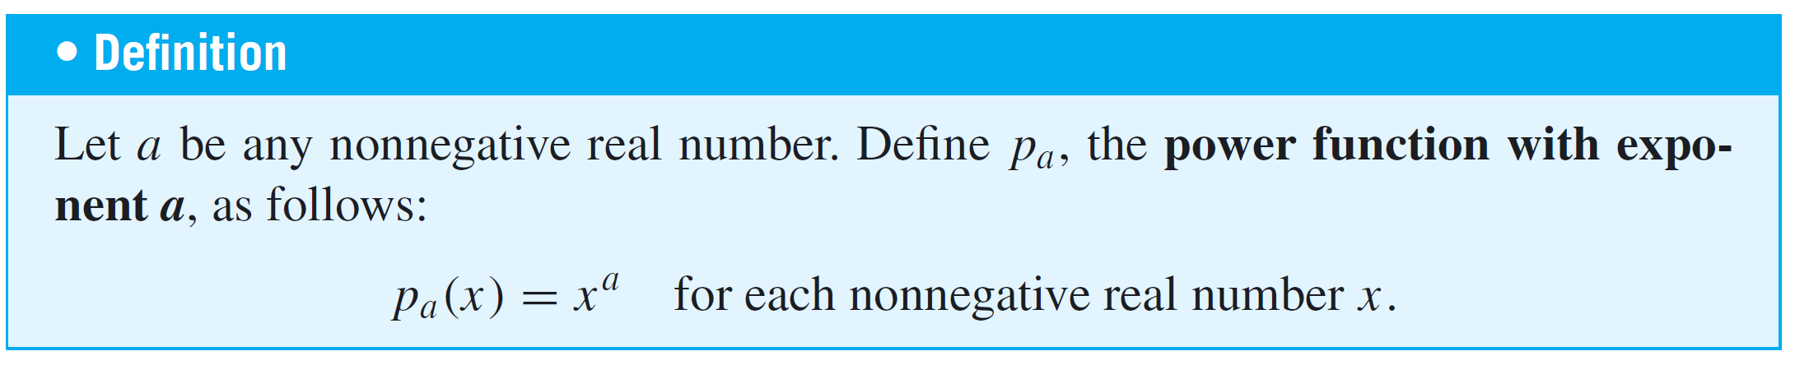
Power Functions
A function that sends a real number x to a particular power, xª, is called a power function.
For applications in computer science, we are almost invariably concerned with situations where x and a are nonnegative, and so we restrict our definition to these cases.

Slide 10
Example 1 – Graphs of Power Functions
Plot the graphs of the power functions p₀, p_{1/2}, p₁, and p₂ on the same coordinate axes.
Solution:
Because the power function with exponent zero satisfies p₀(x) = x⁰ = 1 for all nonnegative numbers x, all points of the form (x, 1) lie on the graph of p₀ for all such x.
So the graph is just a horizontal half-line of height 1 lying above the horizontal axis.

Slide 11


Example 1 – Solution
cont’d
Similarly, p₁(x) = x for all nonnegative numbers x, and so the graph of p₁ consists of all points of the form (x, x) where x is nonnegative.
The graph is therefore the half-line of slope 1 that emanates from (0, 0).
Since for each nonnegative number any point with coordinates where x is nonnegative, is on the graph of p_{1/2}.

Slide 12
Example 1 – Solution
cont’d
For instance, the graph of p_{1/2} contains the points (0, 0),
(1, 1), (4, 2), and (9, 3).
Similarly, since p₂(x) = x², any point with coordinates (x, x²) lies on the graph of p₂.
Thus, for instance, the graph of p₂ contains the points
(0, 0), (1, 1), (2, 4), and (3, 9).

Slide 13
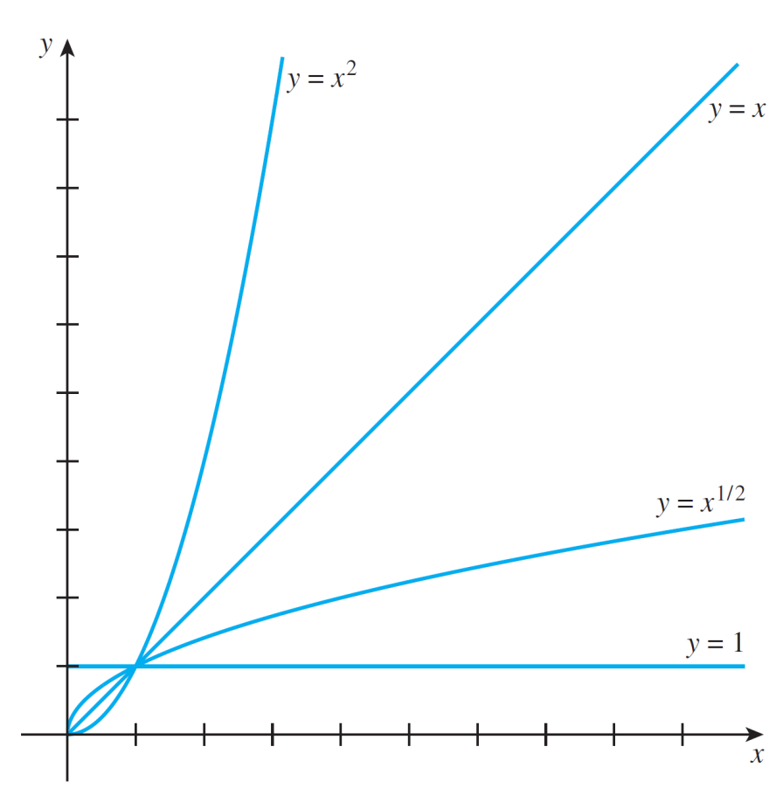
Example 1 – Solution
cont’d
The graphs of all four functions are shown in Figure 11.1.2.
Graphs of Some Power Functions
Figure 11.1.2

Slide 14
The Floor Function

Slide 15
The Floor Function
The floor and ceiling functions arise in many computer science contexts. The next Example illustrates the graph of the floor function.

Slide 16


Example 2 – Graph of the Floor Function
We have known that each real number either is an integer itself or sits between two consecutive integers: For each real number x, there exists a unique integer n such that
The floor of a number is the integer immediately to its left on the number line. More formally, the floor function F is defined by the rule
For each real number x,

Slide 17

Example 2 – Graph of the Floor Function
cont’d
= the greatest integer that is less than or equal to x
= the unique integer n such that
Graph the floor function.
Solution:
If n is any integer, then for each real number x in the interval , the floor of x, , equals n.
Thus on each such interval, the graph of the floor function is horizontal; for each x in the interval, the height of the graph is n.

Slide 18
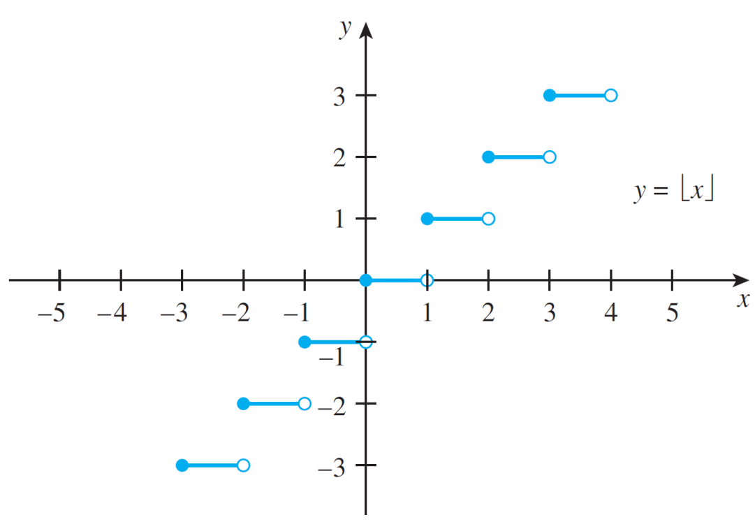
Example 2 – Solution
cont’d
It follows that the graph of the floor function consists of horizontal line segments, like a staircase, as shown in Figure 11.1.3.
The open circles at the
right-hand edge of each
step are used to show
that those points are
not on the graph.
Graph of the Floor Function
Figure 11.1.3

Slide 19
Graphing Functions Defined
on Sets of Integers

Slide 20
Graphing Functions Defined on Sets of Integers
Many real-valued functions used in computer science are defined on sets of integers and not on intervals of real numbers.
Suppose you know what the graph of a function looks
like when it is given by a certain formula on an interval of real numbers.
You can obtain the graph of the function defined by the same formula on the integers in the interval by selecting out only those points on the known graph with integers as their first coordinates.

Slide 21
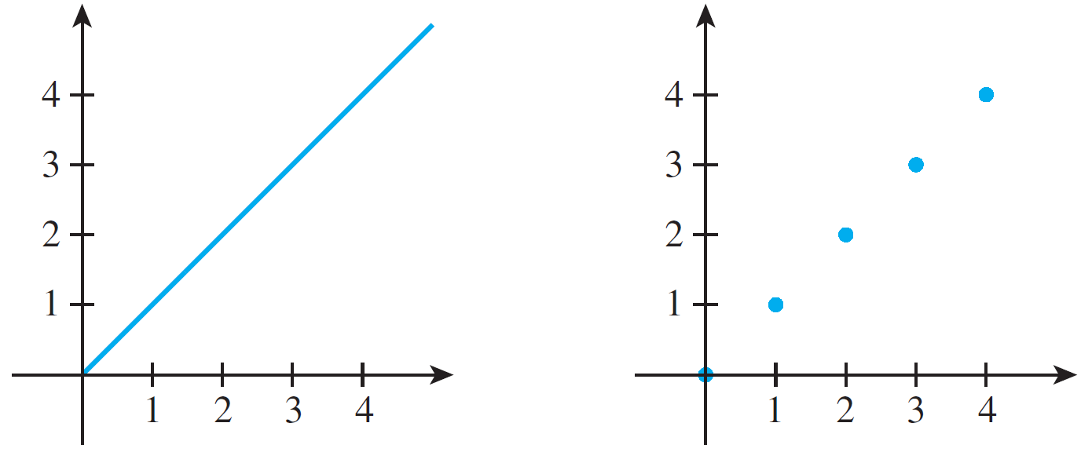
Graphing Functions Defined on Sets of Integers
For instance, if f is the function defined by the same formula as the power function p₁ but having as its domain the set of nonnegative integers, then f (n) = n for all nonnegative integers n. The graphs of p₁, reproduced from Example 2, and f are shown side-by-side below.
Graph of p₁ where p₁(x) = x
for all nonnegative real numbers x
Graph of f where f (n) = n
for all nonnegative integers n

Slide 22
Example 3 – Graph of a Function Defined on a Set of Integers
Consider an integer version of the power function p_{1/2}.
In other words, define a function g by the formula g(n) = n^{1/2} for all nonnegative integers n. Draw the graph of g.
Solution:
Look at the graph of p_{1/2} in
Figure 11.1.2.
Draw the graph of g by reproducing
only those points on the graph of
p_{1/2} with integer first coordinates.
Graphs of Some Power Functions
Figure 11.1.2

Slide 23
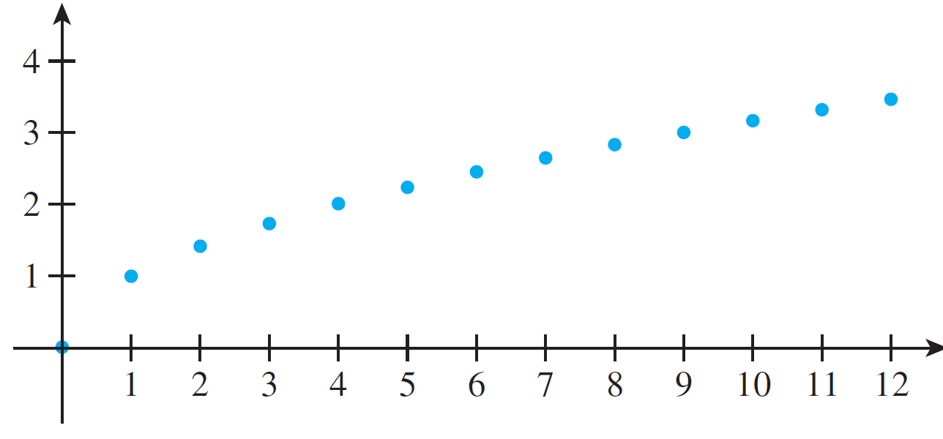
Example 3 – Solution
cont’d
Thus for each nonnegative integer n, the point (n, n^{1/2}) is on the graph of g.
Graphs of g where g(n) = n^{1/2} for all nonnegative integers n

Slide 24
Graph of a Multiple of a Function

Slide 25
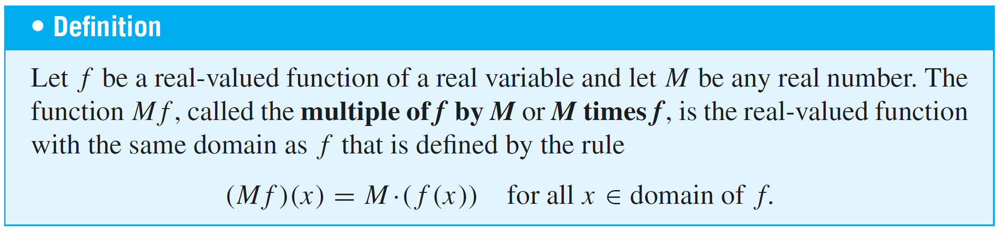
Graph of a Multiple of a Function
A multiple of a function is obtained by multiplying every value of the function by a fixed number.
To understand the concept of O-notation, it is helpful to understand the relation between the graph of a function and the graph of a multiple of the function.

Slide 26
Graph of a Multiple of a Function
If the graph of a function is known, the graph of any multiple can easily be deduced.
Specifically, if f is a function and M is a real number, the height of the graph of Mf at any real number x is M times the quantity f (x).
To sketch the graph of Mf from the graph of f, you plot the heights M  (f (x)) on the basis of knowledge of M and visual
inspection of the heights f (x).

Slide 27
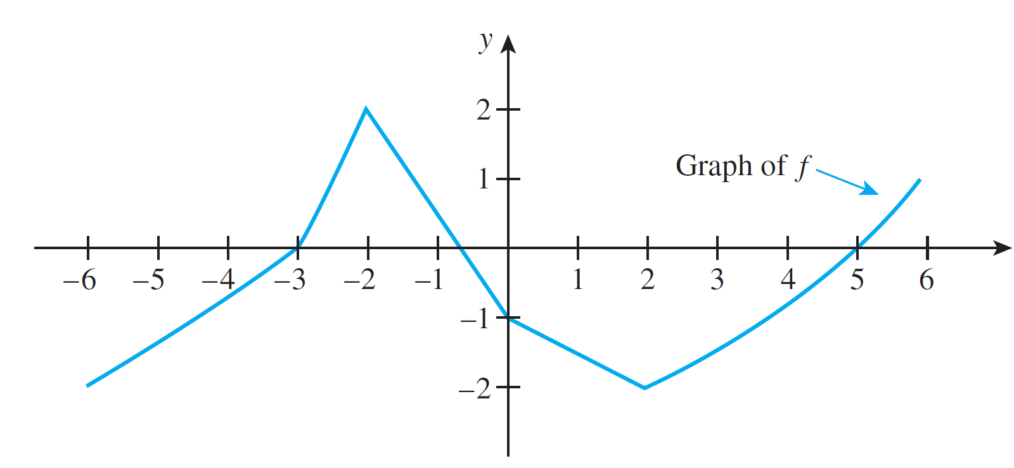
Example 4 – Graph of a Multiple of a Function
Let f be the function whose graph is shown below. Sketch the graph of 2f.

Slide 28
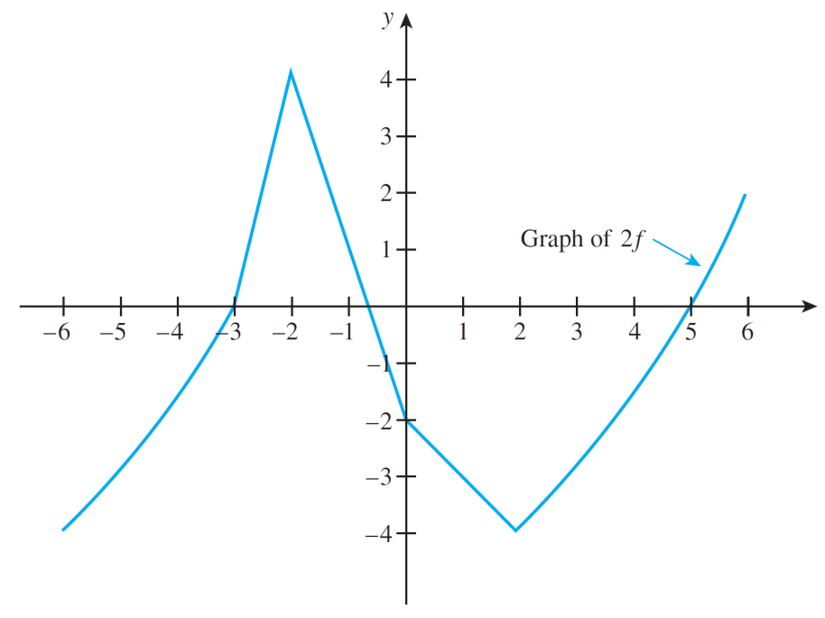
Example 4 – Solution
cont’d
At each real number x, you obtain the height of the graph of 2f by measuring the height of the graph of f at x and multiplying that number by 2.
The result is the following graph.

Slide 29
Example 4 – Solution
cont’d
Note that the general shapes of f and 2f are very similar, but the graph of 2f is “stretched out”: the “highs” are twice as high and the “lows” are twice as low.

Slide 30
Increasing and Decreasing Functions

Slide 31
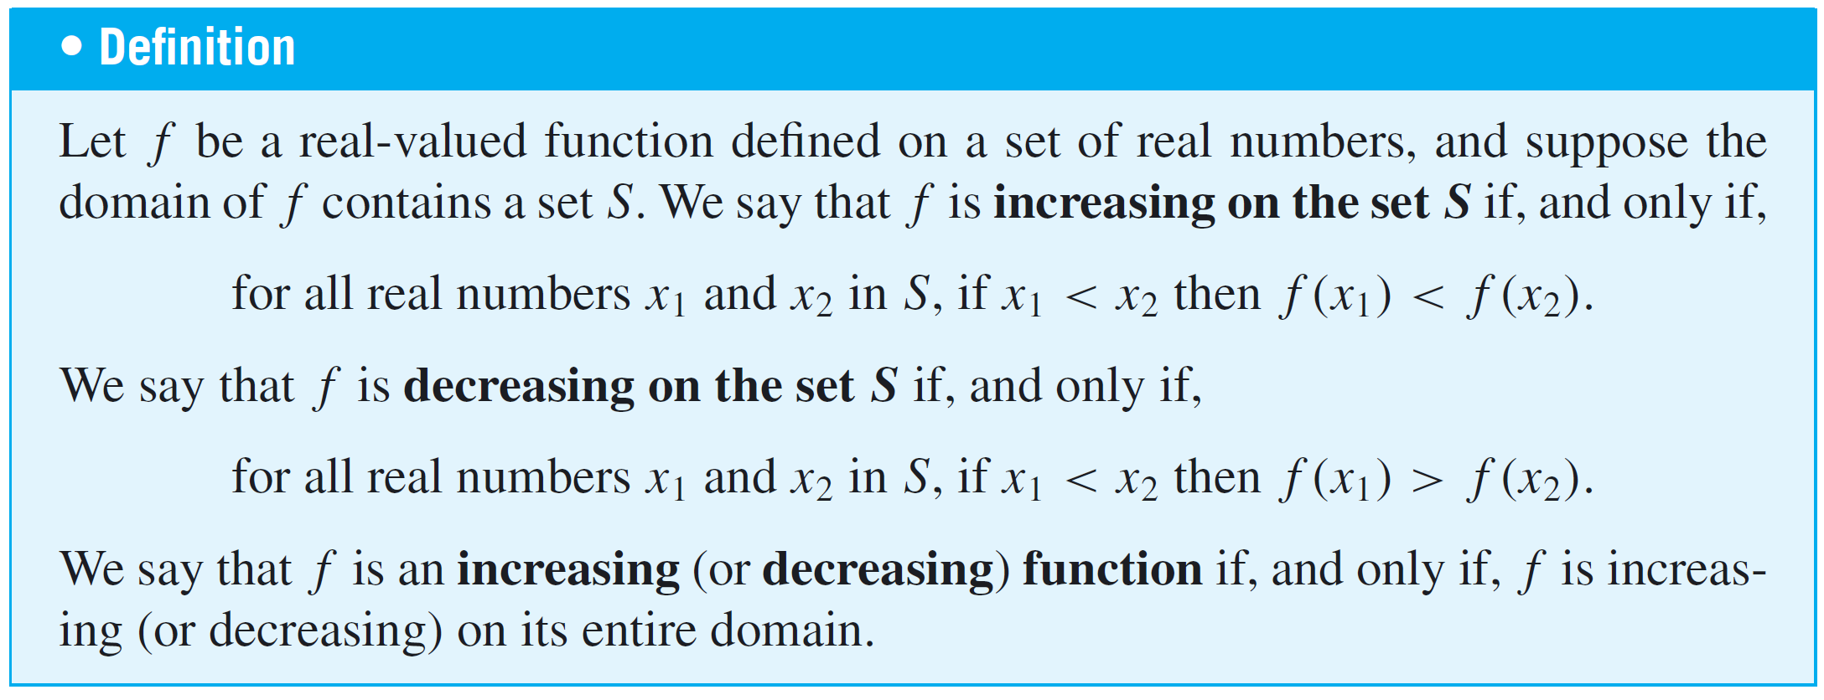
Increasing and Decreasing Functions

Slide 32
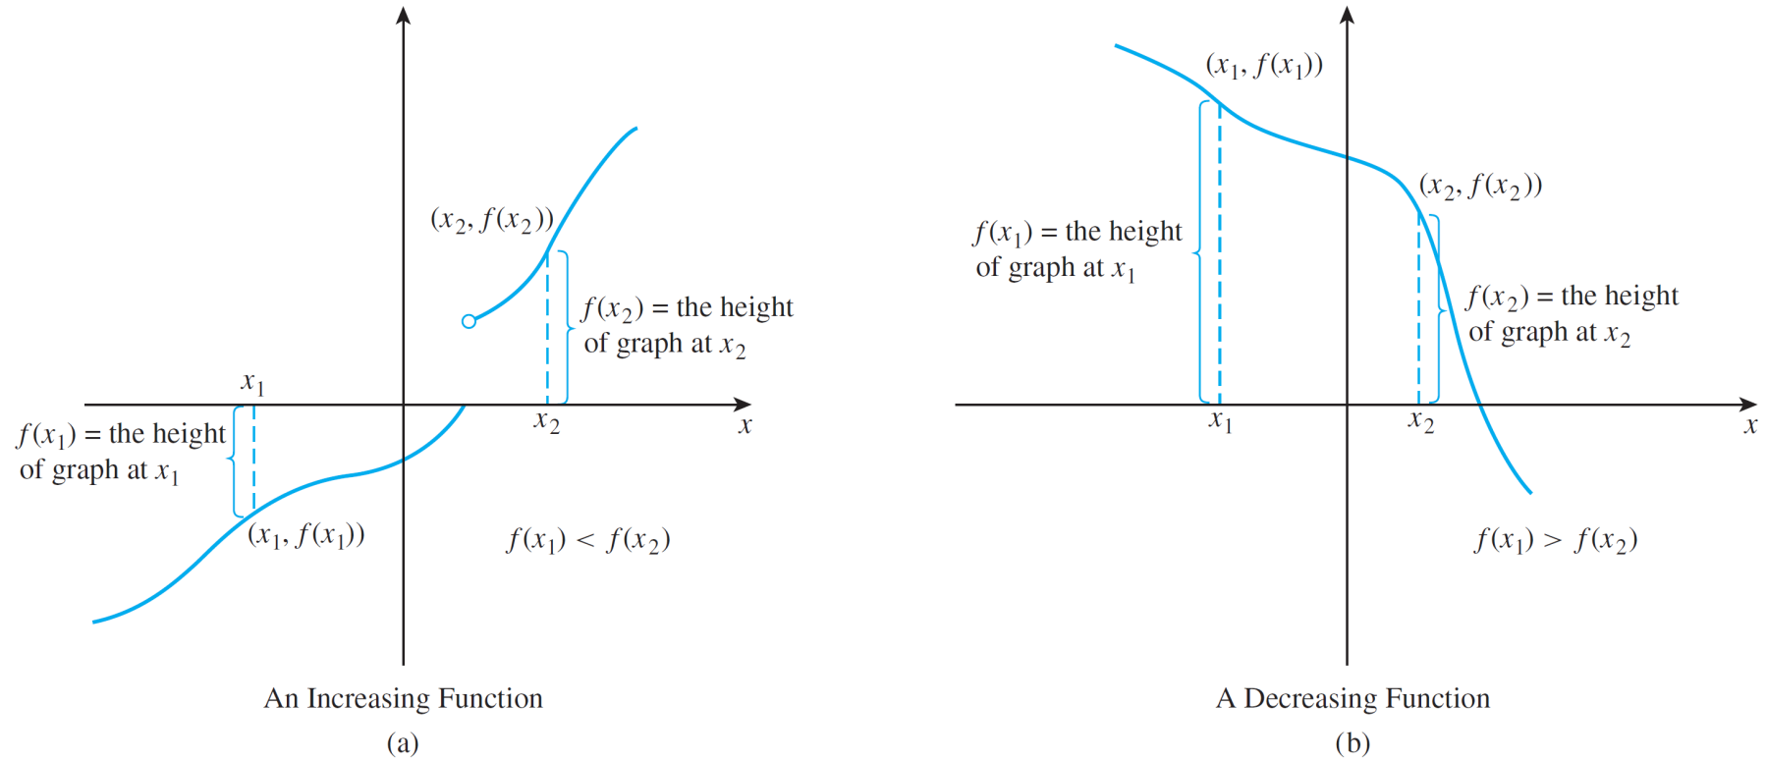
Increasing and Decreasing Functions
Figure 11.1.5 illustrates the analytic definitions of increasing and decreasing.
Figure 11.1.5

Slide 33
Increasing and Decreasing Functions
It follows almost immediately from the definitions that both increasing functions and decreasing functions are
one-to-one.

Slide 34
Example 5 – A Positive Multiple of an Increasing Function Is Increasing
Suppose that f is a real-valued function of a real variable that is increasing on a set S of real numbers, and suppose M is any positive real number. Show that Mf is also increasing on S.
Solution:
Suppose x₁ and x₂ are particular but arbitrarily chosen elements of S such that
x₁ < x₂.
[We must show that (Mf)(x₁) < (Mf)(x₂).]

Slide 35
Example 5 – Solution
cont’d
From the facts that x₁ < x₂ and f is increasing, it follows that
f (x₁) < f (x₂).
Then
Mf (x₁) < Mf (x₂),
since multiplying both sides of the inequality by a positive number does not change the direction of the inequality.
Hence, by definition of Mf,
(Mf)(x₁) < (Mf)(x₂),
and, consequently, Mf is increasing on S.

Slide 36
Increasing and Decreasing Functions
It is also true that a positive multiple of a decreasing function is decreasing, that a negative multiple of a increasing function is decreasing, and that a negative multiple of a decreasing function is increasing.

